Slide 1

EvoGame:
Evolving Game Strategies Using GE (Grammatical Evolution)
FYP Presentation 2025/26
Cormac Greaney / 22352228
Supervisor: Prof. Conor Ryan
University of Limerick
Date: 31/10/2025

Slide 2
Contents
Project Overview
Objectives
Motivation
Progress to Date
Planned work
Timeline
Challenges + Considerations

Slide 3
Project Overview
EvoGame is a system where game strategies for draughts, a simple turn-based game are evolved using GE. The project will involve defining a grammar that specifies possible moves and tactics and then using grammatical evolution to iteratively improve these strategies. By simulating thousands of games, the evolved strategies can be tested and refined to find the optimal approach.
Using the GRAPE engine developed here in UL which implements GE in DEAP
Several phases of game complexity scaled up as the project progresses. Starting with a smaller board and less complex rule set
Human prototype testing gauging real world success

Slide 4
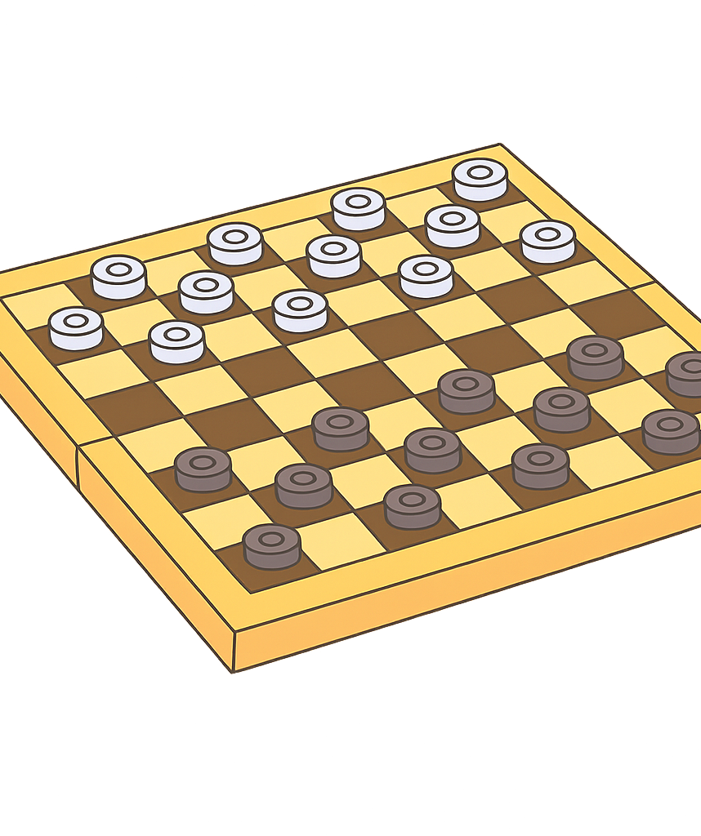
Objectives
Develop a system that evolves strategies for draughts using grammatical evolution
Implement and optimize a grammar that defines possible game strategies
Analyse and visualize the evolution of strategies over multiple generations
Iterate these objectives over multiple phases of scaling game complexity
Measure the success of the developed strategies for each phase and for the final phase use human competitors to gauge the real-world success

Slide 5
Motivation
Project
Personal
Traditional game AI relies on hand-coded logic that is predictable
GE can evolve adaptive solutions, this project will explore the benefit of that and measure its real-world performance
This is a worthy research area as it's not been explored nearly as much traditional AI solutions using minmax etc.
I chose Draughts because of its turn-based nature, clear rules and easily scalable complexity, this makes it an ideal choice for a phased GE project
I chose GRAPE as it is more user friendly and better suited for this project than the alternative
I’ve applied for an MSc in Artificial Intelligence and Machine Learning for next year and am interested in working with machine learning in the future
As such I wanted to make sure my FYP had some relation to this to give me more experience going into next year
GRAPE and Grammatical Evolution itself were developed in UL and working with them is an exciting prospect to me

Slide 6
Existing Draughts Bots – WHY GE is still worth it
Draughts is solved
Chinook – University of Alberta
When this program plays two perfect solutions against each other it will always be a draw
Uses brute force search + endgame databases
Then why bother using GE?
Chinook has actually still been beaten by humans using different sneaky techniques, adaptive solutions from GE would learn to fight these
GE could prove better at playing timed modes for real world play
GE could provide solutions much quicker, without a need for as much expert knowledge or computational power
Most popular methods behind current Draughts Bots
Traditional AI(minmax) – only becomes nearly unbeatable at high search depth
Online games mostly use shallow minmax with some heuristics but can be beaten by experienced players (247Checkers, PlayOK, AI Factory)

Slide 7
Progress to Date
Background Research
I have been following along with relevant sections of CS6271 which covers a lot of the basics of grammatical evolution and other evolutionary computation concepts
I have been researching the theory behind GE along with various research projects that implement GE as well as other evolutionary approaches
I have investigated existing draughts bots and the processes behind them
Creating a simplified python version of Draughts
I have created a python version of draughts with a simplified rule set and a smaller board
Designing the Phase 1 Grammar
The first version of the Grammar that I will use has been designed, this is proving to be one of the more complex aspects of the project
Phase 1 Development
I have started work on developing the integration of GRAPE with the simplified version of draughts and the defined Grammar
Ethics Application
I have written an application to test the developed strategies against human participants in a later stage of the project

Slide 8
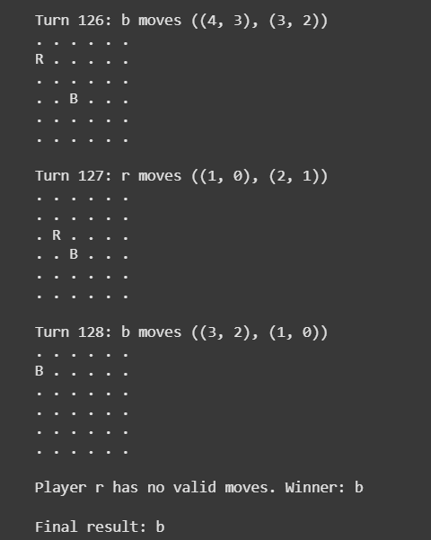
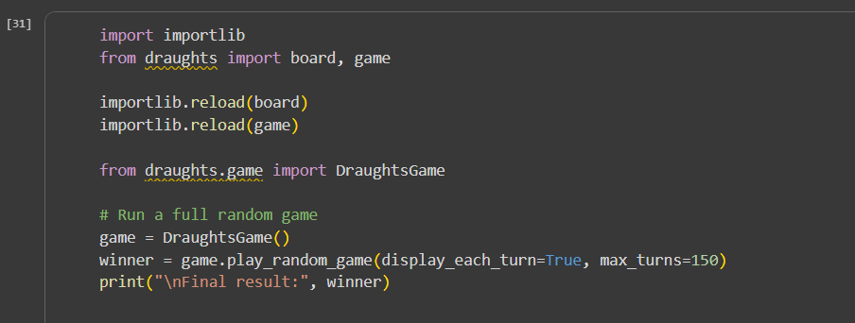
My simplified version of draughts created in python
-Here we can see a sample game played with random moves

Slide 9
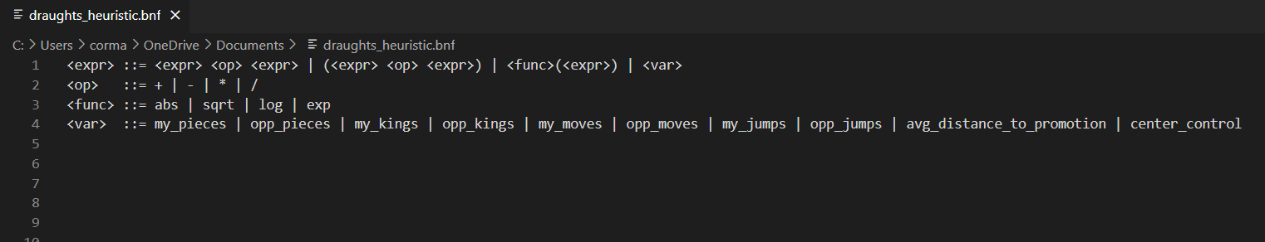
Draft BNF Grammar:

Slide 10
Planned Work
Short Term
Long Term
Continue research and continue to increase my fundamental understanding of GE
Finalize grammar design and integrate with the first simplified version of draughts
Run initial GE experiments and evaluate the resulting strategies
Improve grammar and the fitness function
Scale up the game complexity to standard draughts in phases
Add a UI for human prototype testing
Analysis and visualization of the evolution process

Slide 11
Expected Timeline
Given the current semester’s workload it’s likely
that the progress will be concentrated around the
Christmas holidays when no other projects are running
Research and Setup
First evolution experiments
2025
JAN
FEB
MAR
APR
MAY
JUN
JUL
AUG
SEP
OCT
NOV
DEC
2026
JAN
FEB
MAR
APR
MAY
JUN
JUL
AUG
SEP
OCT
NOV
DEC
Refinement and scaling of game complexity
UI development and human testing
Final analysis and report

Slide 12
Challenges and considerations
Integrating GRAPE with custom Draughts environments is technical
Designing the grammar is complex
Defining a fitness function that is meaningful
Scaling complexity (how complex to be for each stage)
Managing time to meet deadlines and equally divide work amongst different aspects of the project

Slide 13
THANK YOU For Listening
Any Questions?
Cormac Greaney
22352228@studentmail.ul.ie

